Slide 1
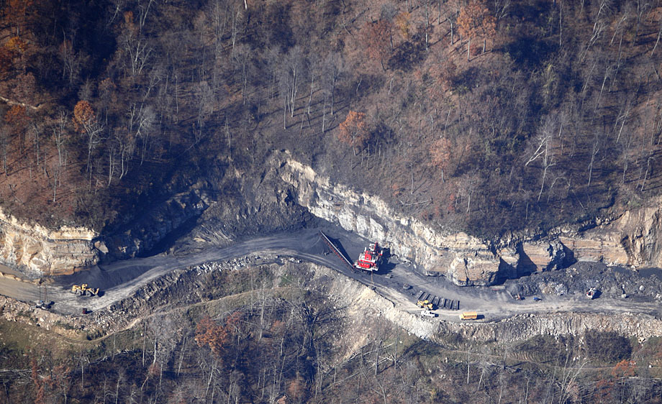
Natural Resource Valuation Instructors:
Vance Mosley
Coby Mosley

Slide 2
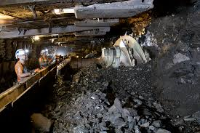
Introduction
Objective: The objective of this class is to briefly discuss the principles, definitions and procedures used in natural resource valuation.
Topics Discussed
Natural Resources
Property Rights
Mineral Rights
Mineral Reserve Estimation
Highest and Best Use
Market Value
Mineral Valuation
Approaches to Value
Sales Comparison Approach
Income Capitalization Approach
Timber Valuation
Contact Information

Slide 3
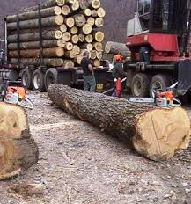
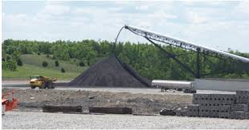
What are Natural Resources?
Natural Resource: Something (as a mineral, waterpower source, forest, or kind of animal) that is found in nature and is valuable to humans (as in providing a source of energy, recreation, or scenic beauty. (Merriam-Webster Dictionary).
Coal
Oil/Gas
Timber
Water
Other Minerals
(copper, gold, silver)
Etc.

Slide 4
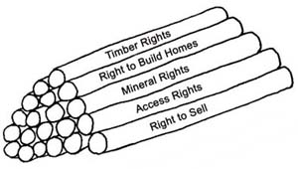
Property Rights
Fee Simple: Absolute ownership, unencumbered by any other interest or estate’ subject only to powers of Government. (Appraisal of Real Property, 2nd Edition, ASFMRA, Page 47).
Partial Interest: Ownership of less than fee simple (rights subject to things such as a road right-of-way, power-lines, mineral only ownership. Mineral only ownership is a partial interest.
Bundle of Rights (bundle of sticks)

Slide 5
Mineral Rights
Mineral Rights: Is the rights and ownership to extract all minerals contained in or below the surface of a property.
Mineral rights can be granted with surface rights or without surface entry because the “mineral estate” is the dominant estate in most states.
Mining Right: is the rights to enter upon and occupy a property for mining purposes for under ground mining or surface mining purposes. This could also include the right to use of vegetative resources in the mining process.
Royalty: Is a reservation to the lessor or seller of a certain portion of the minerals, or proceeds from their sale, at no cost to the lessor.
(American Society of Farm Managers & Rural Appraisers Section 5 Pg. 1 Minerals Appraisal book)

Slide 6
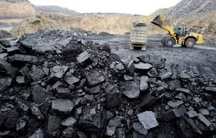
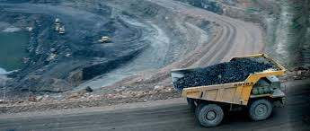
Mineral Reserve Estimation
Determining Mineral Reserves
Operating Units with proven Reserves-out crops, core holes and mine openings. Typically only proven and probable reserves are used in appraisal assignments.
Mineral reserve estimation is generally determined by geologists, KY Geological Survey, KY Mine Mapping Information System, the US bureau of Mines, and simple on site coal seam measurements etc.
Prospects: Properties in all stages of mining development including inactive mines.
Coal reserves estimated by use of 1,800 tons/acre ft. or 145 tons/acre inch.

Slide 7
Highest and Best Use
Highest and Best Use: That reasonable probable and legal use of vacant land or an improved property, which is physically possible, appropriately supported, financially feasible, and that results in the highest value. The four criteria the highest and best use must meet are legal permissibility, physical possibility, financial feasibility, and maximum profitability. Page 22 The Appraisal of Real Estate Twelfth Edition.
Example #1: 100 acre vacant woodland property located in eastern Kentucky with excellent coal reserves , good access for mining, not zoned or restricted for mining use and surrounding properties are being extensively mined in same coal seam.
HBU = Mining.
Example #2: 100 acre vacant woodland property located in eastern Kentucky with excellent coal reserves, good access for mining, zoned residential and surrounding properties are being extensively mined in same coal seams.
HBU = Residential.
Example #3: 100 acres of Hazard #4 coal seam only. HBU = Mining

Slide 8
What is Market Value?
In appraising Mineral Rights we are generally asked to determine the market value of such property rights.
Market value: is The most probable price, as of a
specified date, in cash, or in terms equivalent to cash, or in other precisely revealed terms, for which the specified
property rights should sell after reasonable exposure in a competitive market under all conditions requisite to a fair sale, with the buyer and seller each acting prudently, knowledgeably, and for self-interest, and assuming that neither is under undue duress. The Appraisal of Real Estate 2th Edition Pg. 22.
Other forms of value
Liquidation Value, Use Value ,Investment Value etc. Are
other forms of value reported by appraisers but not
mentioned and beyond the scope of this class.

Slide 9
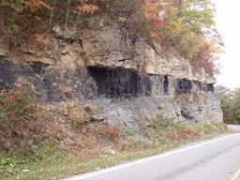
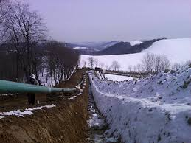
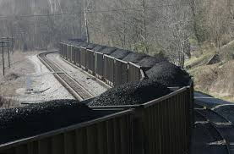
Mineral Property Valuation
What is the “Estate Appraised” discussed with the Client?
Highest and Best Use= Mineral extraction/Mining
When appraising mineral property appraisers must look at how market factors influence the property being appraised as a whole.
The most important variable in the evaluation of mineral rights is “Risk”. Caused by external factors such as commodity prices, fuel costs, weather, market outlook and regulation.

Slide 10
Approaches to Value
Sales Comparison Approach
Appraisal Approaches Used
Sales Comparison Approach: A set of procedures in which a value indication is derived by comparing the property being appraised to similar properties that have sold recently, applying appropriate units of comparison, and making adjustments to the sale prices of the comparable based on elements of comparison. (The Appraisal of Real Estate 12th Edition Pg. 417)
Appraisers obtain comparable sales in the market and break
them down to value/ton inplace and make direct sales
comparison adjustments to sales making the sales like the
subject. Generally the most reliable approach to value when data is
available.
Example: Mineral only property sold to a coal company exclusively for
mining purposes for a sale price of $4,000,000 contained 2,000 acres
and 5,000,000 tons of coal inplace.
$4,000,000 sale price/ 5,000,000 tons coal inplace = $0.80/ton in place.

Slide 11
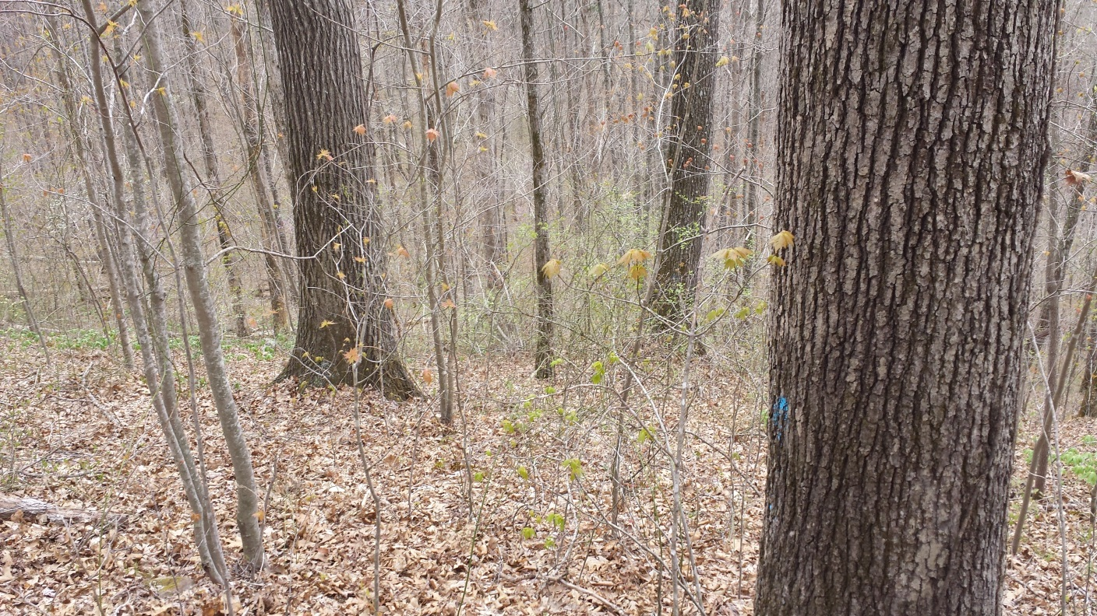
Approaches to Value
Income Capitalization Approach
Appraisal Approaches Used
Income Capitalization Approach: An appraiser analyzes a property’s capacity to generate future benefits and capitalizes the income into an indication of present value.
Discounted Cash Flow (DCF): Is a procedure in which a yield rate or discount rate is
applied to a set of projected income streams and a reversion to determine a present
value.
In mineral appraisals DCF determines the present value of future net income
(gross income – costs)by use of a yield/discount rate. Discount rates are determined by
risk and market factors.
Payments can be made annually or on a lump sum basis for oil/gas, coal or other
mineral properties.
In valuing mineral only property the “present value of 1” concept is applied in
which the future value of the royalty interest is discounted to the present value by use
of a discount rate for a typical mining and/or leasing term.

Slide 12
Timber Valuation
Timber rights: Ownership of the standing timber only which can be in perpetuity but is most often for a set period of time. (1-2 years typically)
Example: Right for logging company to occupy and harvest standing timber for a set period of time until timber is harvested and land reclaimed.
Stumpage Value- Value of logs delivered to the mill less logging/transportation costs. Value a landowner receives for contracting the right for a logger to cut and remove his timber.
Sales Comparison Approach: Using comparable sales of timber only property and making adjustments to comps to make them like the subject.
Empirical Method: Stumpage value = Price paid at the Mill for logs – Logging/delivery costs.

Slide 13
Contact Information
Vance Mosley
Certified General Appraiser
KY Field Service Realty Inc.
P.O. Box 921
Hyden, KY 41749
Office: 606-672-3856
Cell: 606-275-0252
Coby W. Mosley
Certified General Appraiser
Consulting Forester
KY Field Service Realty Inc.
P.O. Box 921
Hyden, KY 41749
Office: 606-672-3856
Cell: 606-275-9921

